Slide 1
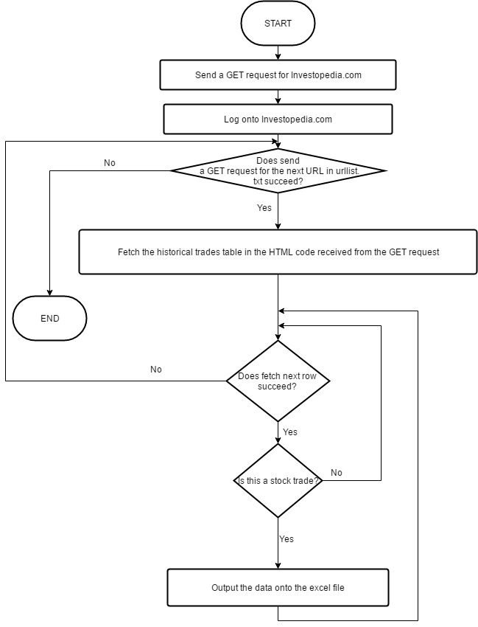
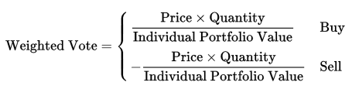
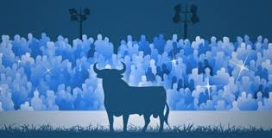

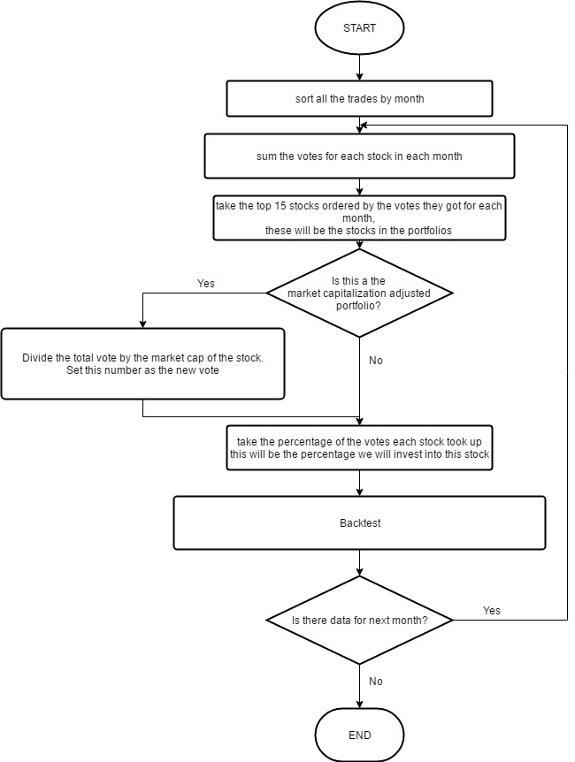
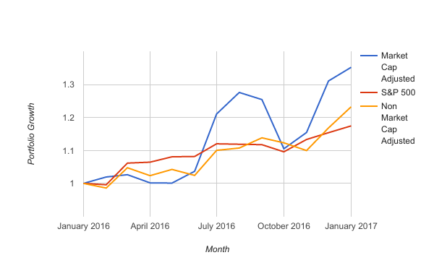
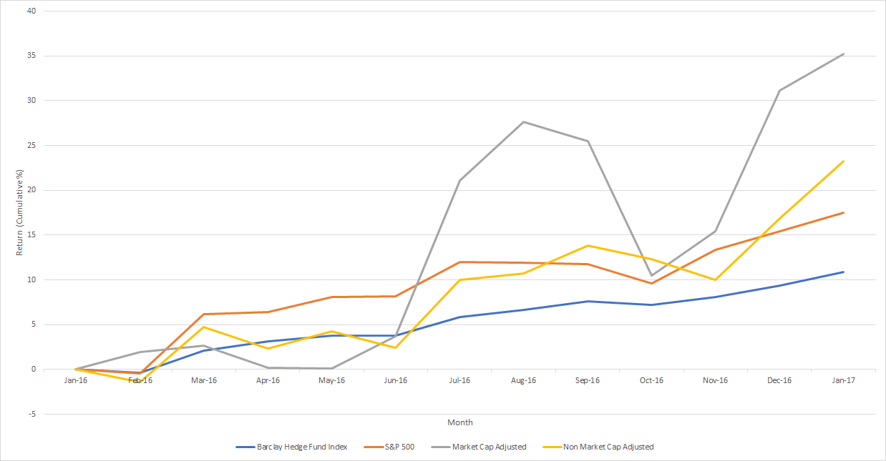
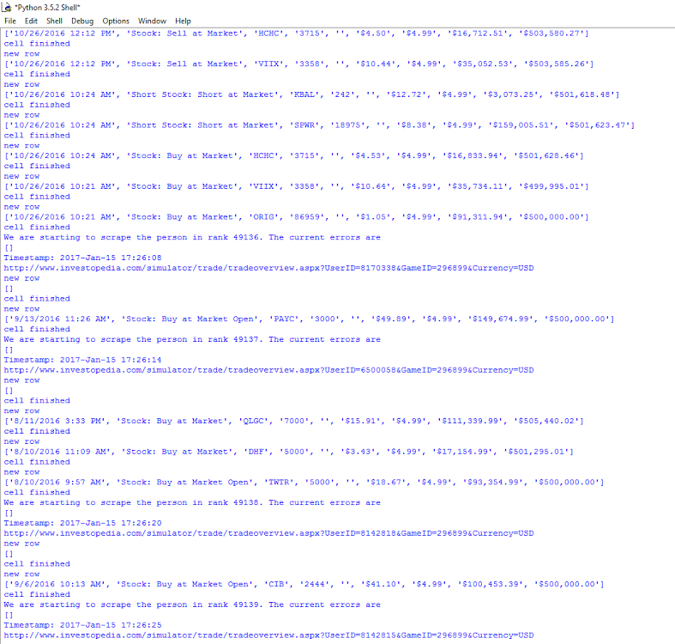
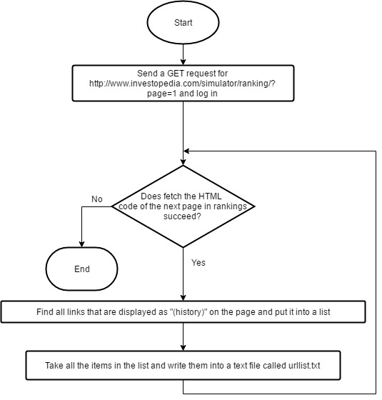
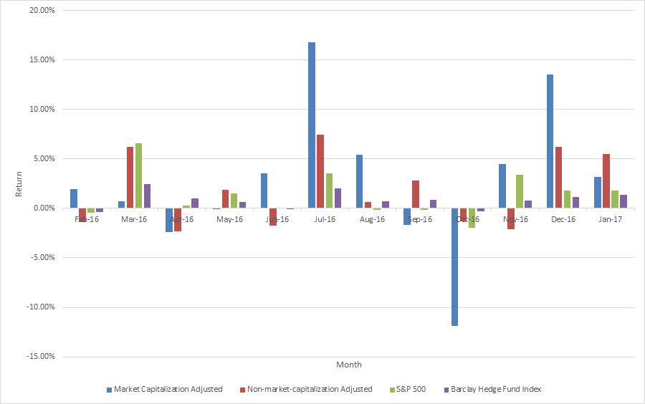
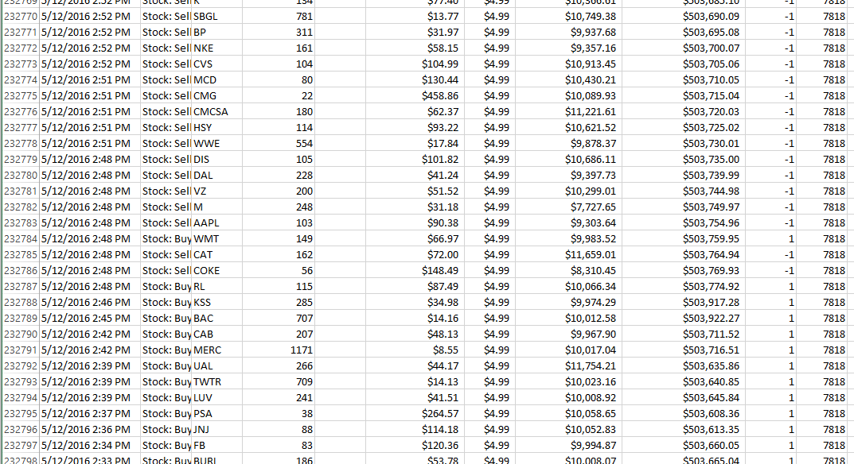
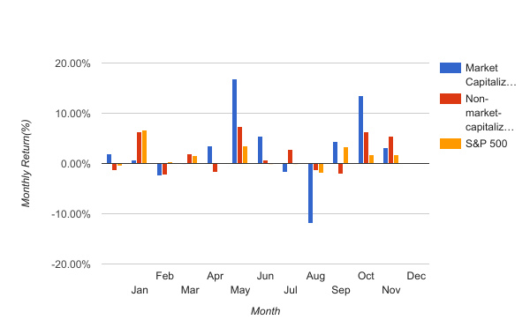
Using Crowdsourcing to form a Profitable Strategy in the Stock Market
Andrew Huang
Project Number: J - MATH - 01
Introduction
Data Analysis
An excel VBA program was developed to datamine the 834,842 trades collected.
Each trade was analyzed as a weighted vote:
The vote is weighted based on each trader’s confidence in their decision
Market Capitalization= Total number shares*stock price
Portfolio Growth
Non-market cap adjusted portfolio had around a 23% yearly increase.
Market-cap adjusted portfolio had a 35% yearly increase,
S&P 500 only had a 17% yearly increase.
Both non-market cap adjusted strategy and market-cap adjusted strategy are superior to S&P 500 in terms of return of year 2016.
Using crowd wisdom on the stock market is a promising approach to effectively trade stocks.
The rise of the Internet and high speed computers drastically increased the amount of information available on the stock market.
The Wisdom of the Crowds: phenomenon in which averaged predictions from a large group of people can rival or even beat the accuracy of subject matter experts
4 Criteria to use wisdom of the crowds:
Independence
Diversity
Decentralisation
Aggregation
IDEA: Datamine a stock market simulator, and use the data to form a trading strategy
Flow chart of data collection program to obtain the trades from each player.
Purpose
To develop computer programs to scrape large amount (~ 1 million) of stock trading data from a stock market trading simulator.
To develop a program to analyze the data, formulate 2 portfolios, backtest, then compare with S&P 500,
To test a crowd wisdom guided approach on trading stock
Cumulative return with non-market cap and market cap adjusted strategies, compared to S&P 500 and Barclay Hedge Fund Index.
Flow chart for portfolio formation
Methods
Results and Discussion
Summary
Data Collections
Python programs were developed to scrape 834,842 stock trades from the Investopedia stock market trading simulator
Monthly Return
Variation of market capitalization strategy is larger than that of non-market capitalization strategy and S&P 500.
Developed a method to use “wisdom of the crowds” on the stock market.
Two portfolios were developed in reflection to the data, and both of them beat the S&P 500 in terms of return.
Crowd wisdom is a promising strategy for stock trading.
Screenshot of the computer program running.
Future Work
Reliability of using crowd wisdom for stock trading needs to be further studied using the data of other years.
Explore the method of “wisdom of crowd” for day trading This will require complete automatization of the process.
Explore crowd wisdom method to other fields (ex. policy formulation, protein folding problem, etc.)
Flow chart of data collection program to obtain the URLs of each player’s trade history.
Sample of the data collected for this study
Monthly return using non-market capitalization and market capitalization strategies compared to S&P 500 and Barclay Hedge Fund Index.
Notes:
Each trade was a vote:
1

